Slide 1
Fundamentals and Methods of Computer Science
Exercise week 2

Slide 2
Today’s Menu
Discussion of assignment 1 and the respective quiz
Brief summary of skills necessary to solve assignment 2
Working on assignment 2

Slide 3
Discussion of assignment 1 and the respective quiz

Slide 4
Assignment 1 & Quiz 1: What the questions were about
Define variables & assign values
Create a calculator (no user input)
Print() (variables, strings, int, float etc.)
Recognize data types
type() and changing var type (int(), str(), float())
Computation with int and float vs.
computation with string and int/float
Understanding code/error messages
If statements
While-Loop and increments
a = ‘Hello World’
b = 5.5
c = 10
d = b + c
# This is a comment:
# In Python we can not define variables
# without assigning a corresponding value
z = None
print(‘Hello World’)
Hello World
print(‘Hello’, ‘World’)
Hello World
x = 5
y = 6
print(x + y)
11
print(‘The result of x + y is’, x + y)
→ The result of x + y is 11

Slide 5
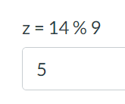
Assignment 1 & Quiz 1: What the questions were about
Define variables & assign values
Create a calculator (no user input)
Print() (variables, strings, int, float etc.)
Recognize data types
type() and changing var type (int(), str(), float())
Computation with int and float vs.
computation with string and int/float
Understanding code/error messages
If statements
While-Loop and increments
Examples of arithmetic operations in Python
Arithmetic rules apply: Parenthesis before power before multiplication/division before addition/subtraction
Python has built-in arithmetic operations. These include +, -, *, /, //, **, %
In computing, the modulo operation returns the remainder of a division, after one number is divided by another (called the modulus of the operation)
Other mathematical operations can be imported with libraries

Slide 6
Assignment 1 & Quiz 1: What the questions were about
Define variables & assign values
Create a calculator (no user input)
Print() (variables, strings, int, float etc.)
Recognize data types
type() and changing var type (int(), str(), float())
Computation with int and float vs.
computation with string and int/float
Understanding code/error messages
If statements
While-Loop and increments
print('Hello World')
Hello World
print('Hello', 'World')
Hello World
x = 5
y = 6
print(x + y)
11
print('The result of x + y is', x + y)
→ The result of x + y is 11
print(f'The result of x + y is {x + y}’)
→ The result of x + y is 11
print(‘Hello World’)
Hello World
print(‘Hello’, ‘World’)
Hello World
x = 5
y = 6
print(x + y)
11
print(‘The result of x + y is’, x + y)
→ The result of x + y is 11

Slide 7
Assignment 1 & Quiz 1: What the questions were about
Define variables & assign values
Create a calculator (no user input)
Print() (variables, strings, int, float etc.)
Recognize data types
type() and changing var type (int(), str(), float())
Computation with int and float vs.
computation with string and int/float
Understanding code/error messages
If statements
While-Loop and increments
Type | What? | Short | Example
Integer | Natural numbers | int | -42, 0, 1000
Float | Floating point value | float | -42.0, 0.7, 3.14
String | Concatenation of characters | str | '42‘, 'Hello‘, '3.14'
Boolean | Type with one of two possible values | bool | True, False

Slide 8
Assignment 1 & Quiz 1: What the questions were about
Define variables & assign values
Create a calculator (no user input)
Print() (variables, strings, int, float etc.)
Recognize data types
type() and changing var type (int(), str(), float())
Computation with int and float vs.
computation with string and int/float
Understanding code/error messages
If statements
While-Loop and increments
a = ‘Hello World’
type(a)
str
b = 5.5
type(b)
float
c = 5
type(c)
int
c = str(c)
type(c)
str

Slide 9
Assignment 1 & Quiz 1: What the questions were about
This is a comment
Define variables & assign values
Create a calculator (no user input)
Print() (variables, strings, int, float etc.)
Recognize data types
type() and changing var type (int(), str(), float())
Computation with int and float vs.
computation with string and int/float
Understanding code/error messages
If statements
While-Loop and increments
x = 4
y = 5
# int and int operations yield int
print(x + y)
→ 9
x = 4
y = 5.0
# int and float operations yield float
print(x + y)
9.0
x = 45
y = 5
# divisions always yield float
print(x / y)
→ 9.0
x = 4
y = “5”
# cannot use arithmetic operations on number and strings. A string can be converted (e.g., int(“5”).
x = “4”
y = “5”
# adding strings is like attaching one string to another
print(x + y)
→ 45
(this is the string “45”)

Slide 10
Assignment 1 & Quiz 1: What the questions were about
Define variables & assign values
Create a calculator (no user input)
Print() (variables, strings, int, float etc.)
Recognize data types
type() and changing var type (int(), str(), float())
Computation with int and float vs.
computation with string and int/float
Understanding code/error messages
If statements
While-Loop and increments

Slide 11
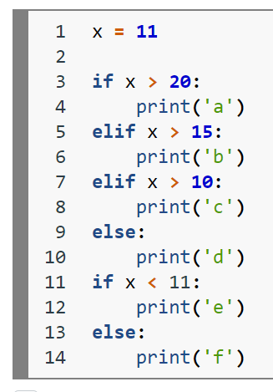
Assignment 1 & Quiz 1: What the questions were about
Define variables & assign values
Create a calculator (no user input)
Print() (variables, strings, int, float etc.)
Recognize data types
type() and changing var type (int(), str(), float())
Computation with int and float vs.
computation with string and int/float
Understanding code/error messages
If statements → today in detail
While-Loop and increments
Run this only if the initial
if-statement evaluates to True
Run this only if the elif-state-
ment is True AND all state-
ment above have been False.
Run this only if the statements
before this line have all been
False.
This if-statement will be tested
irrespective of the first if-statement

Slide 12
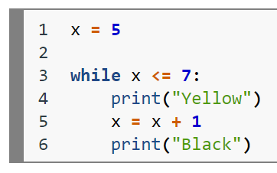
Assignment 1 & Quiz 1: What the questions were about
Define variables & assign values
Create a calculator (no user input)
Print() (variables, strings, int, float etc.)
Recognize data types
type() and changing var type (int(), str(), float())
Computation with int and float vs.
computation with string and int/float
Understanding code/error messages
If statements
While-Loop and increments → today in detail
„While this line is interpeted
as True, do whatever is indented
after the colon (:) and return to
this line“

Slide 13
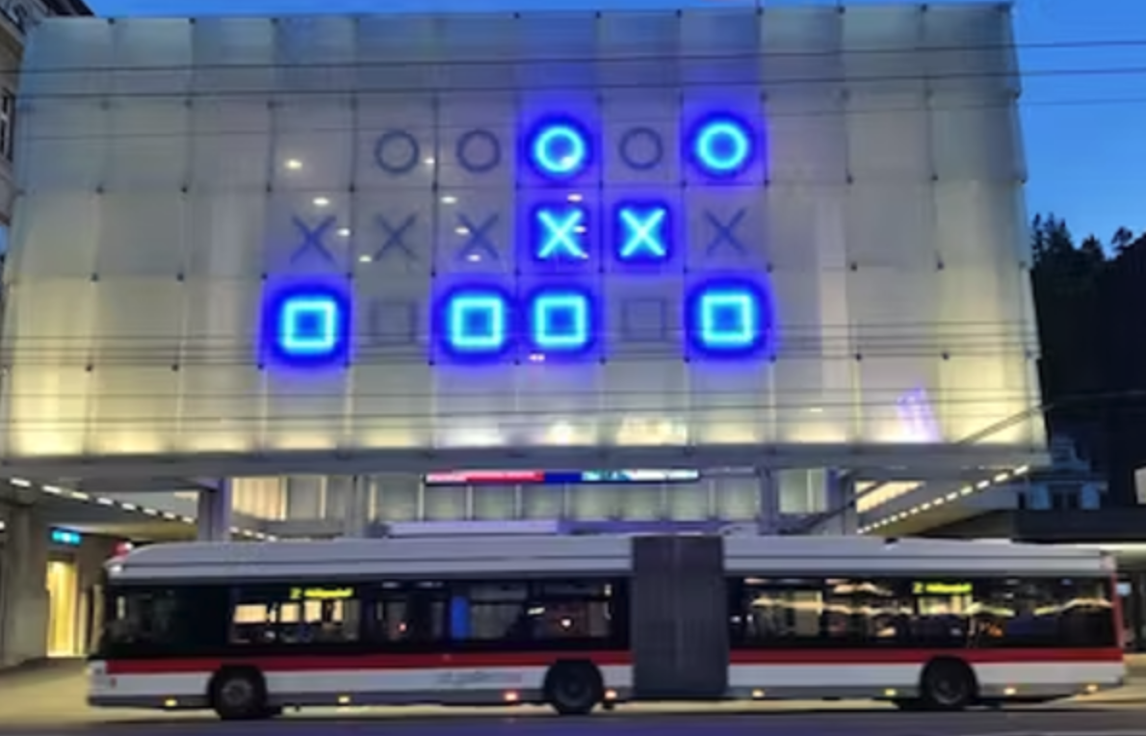
Quiz 1: Theory (Binary)
Hour: 00101b
0 * 2^4 + 0 * 2^3 + 1 * 2^2 + 0 * 2^1 + 1 * 2^0 = 5
Minute: 000110b
0 * 2^5 + 0 * 2^4 + 0 * 2^3 + 1 * 2^2 + 1 * 2^1 + 0 * 2^0 = 6
Second: 101101b
1 * 2^5 + 0 * 2^4 + 1 * 2^3 + 1 * 2^2 + 0 * 2^1 + 1 * 2^0 = 45

Slide 14
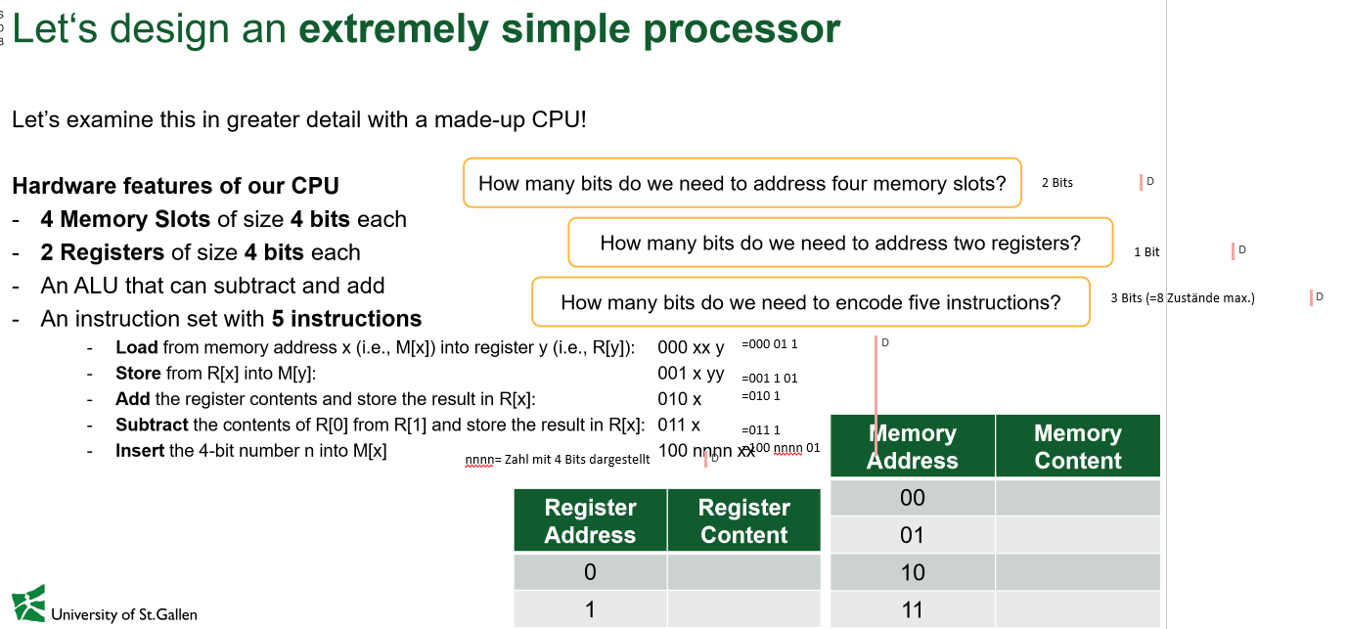
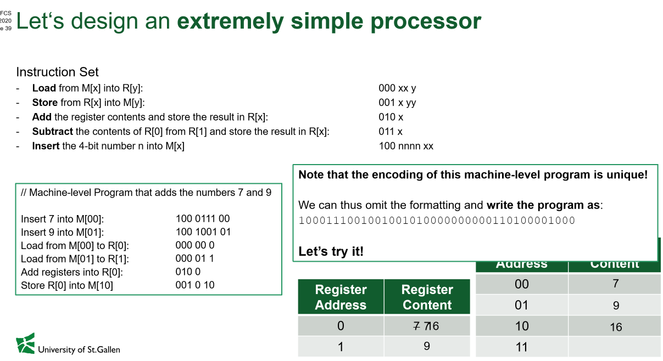

Quiz 1: Theory (Binary) [different program!]
How many bits to address 4 memory slots?
How many bits to address 2 registers?
How many bits to encode 5 instructions?
4 Memory Slots of size 4 bits each An ALU that can subtract & add
2 Registers of size 4 bits each

Slide 15
Quiz 1: Theory (Binary)
Instruction | Exaplanation | Program | Instruction
00nnnx | Insert. The 3-bit binary number nnn_{b} is inserted into register x. | insert the value 2 (in the decimal system) into register 0 | 000100 010b: value 2 0: register 0
01xy | Copy. The content of register x is copied into register y. | copy the value to register 1 | 0101
10xy | Add. The result of R[ x ] + R[ y ] is stored in register y. | add the registers and store the result into register 0 | 1010
11x | Clear. The content of register x is set to 000. | clear register 1 | 111
Program: 000100 0101 1010 111

Slide 16
Brief summary of skills necessary to solve assignment 2

Slide 17
Introduction to Python:
1.5 & 1.8
2
To read up

Slide 18
What are augmented assignments and how do they work?
Augmented assignment | Sample expression | Explanation | Assigns
+= | c += 7 | c = c + 7 | 10 to c
-= | d -= 4 | d = d - 4 | 1 to d
*= | e *= 5 | e = e * 5 | 20 to e
**= | f **= 3 | f = f ** 3 | 8 to f
/= | g /= 2 | g = g / 2 | 4.5 to g
//= | g //= 2 | g = g // 2 | 4 to g
%= | h %= 9 | h = h % 9 | 3 to h

Slide 19
How does the for loop work?
„For every element in a sequence of elements,
do whatever is indented after the colon (:) and
return to this line“
What is a sequence of elements?
Are digits in a number elements of that number?
Are characters in a string elements of that string?
How are ‚final_string‘ and ‚current_string‘ different?
elements = [ ‘H’, ‘a’, ‘l’, ‘l’, ‘o’ ]
final_string = “”
for element in elements:
current_string = element
# append element to final_string
final_string += current_string
print(final_string, current_string)
→ Hallo o

Slide 20
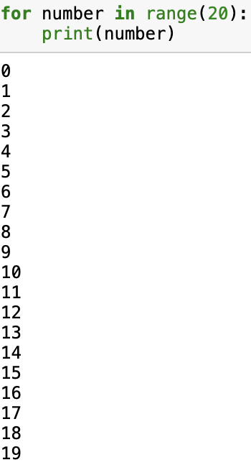
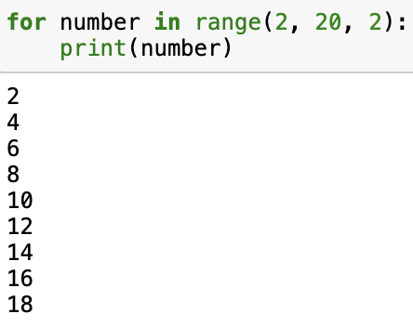
How does range() work?
The range function creates elements (similar to a list) from a starting number to an ending number. The parameters are:
range(start, stop, step)
including
excluding
How to use the function:
range(5) → start at 0, stop before 5, make steps of 1
range(1, 5) → start at 1, stop before 5, make steps of 1
range(1, 5, 2) → start at 1, stop before 5, make steps of 2
range(0, x, 1) → default parameters, if not specified otherwise

Slide 21
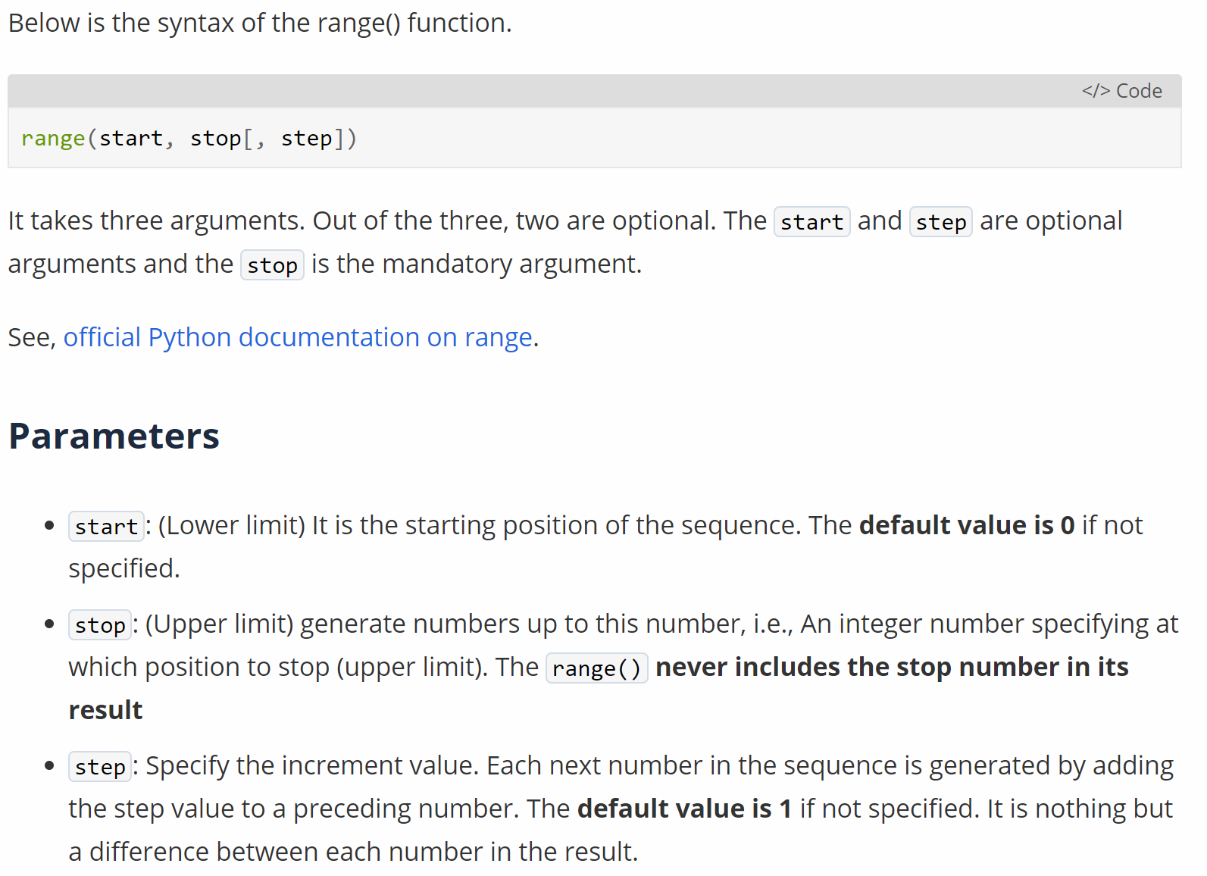
Read Documentation (1)
21

Slide 22
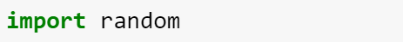
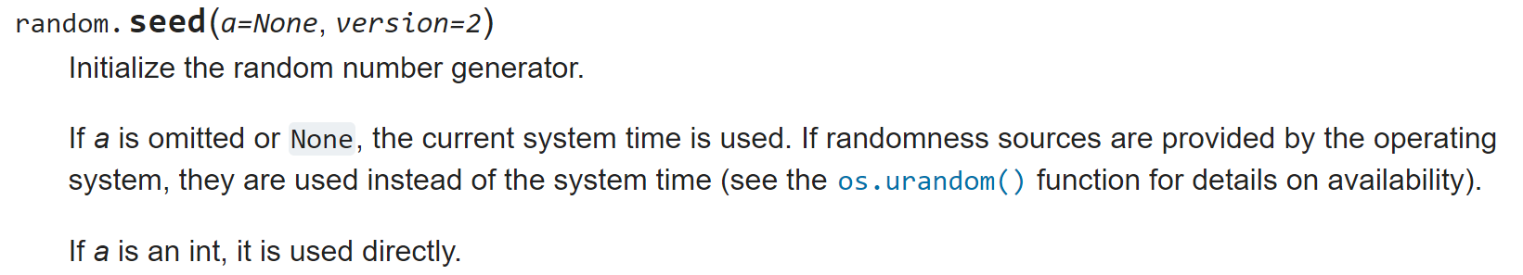
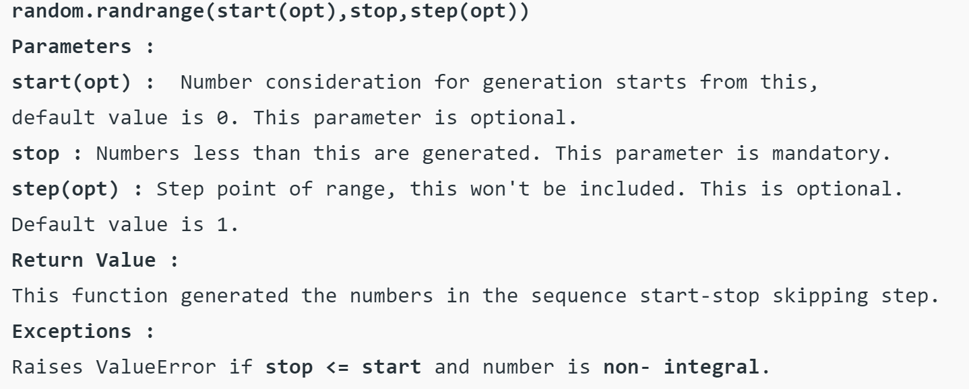
Read Documentation (2)
22

Slide 23
Exercise 2:
Let’s solve the exercise together…
…to enable you to solve the assignment on your own!

Slide 24
Short “summary” of Coding Python in 7 Slides
Let’s take a look at the slides from last week and what is still open.

Slide 25

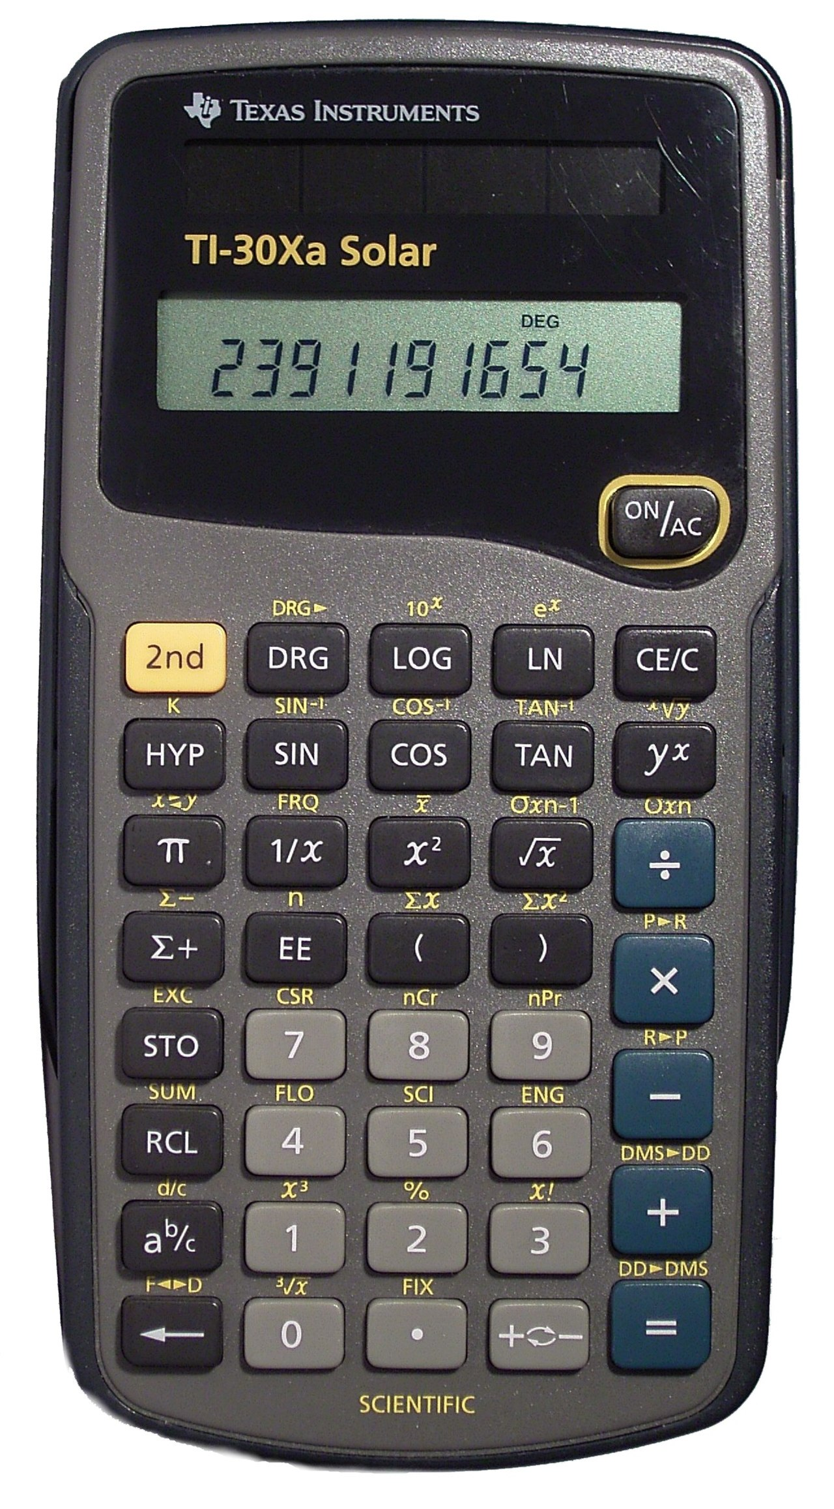
Introduction
A Simple Calculator as your first computer program!
You will learn how to assign values to variables and to do basic calculations
There are among others the following arithmetic operations in Python:
Addition: +
Subtraction: -
Multiplication: *
Division: /
Power Function: **
Example: 3**2 = 9 same as 3^2 (often written like that in Excel)
Modulo Function: %
In computing, the modulo operation returns the remainder of a division, after one number is divided by another (called the modulus of the operation)
Example: 17 % 5 = 2 (15/5 = 3 → the remainder up to 17 is 2)
So, Modulo does integer divisions and returns the remainder

Slide 26
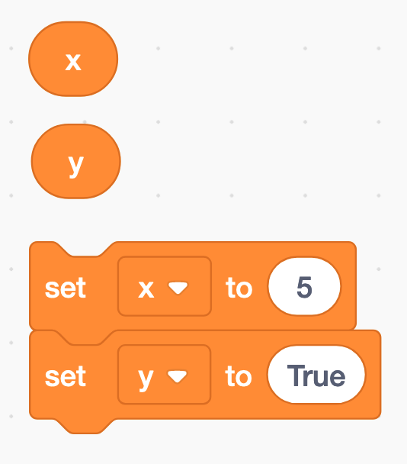
Assigning a value to a variable
The equal sign (=) is used to assign values to variables
x = 5
y = True
etc.

Slide 27
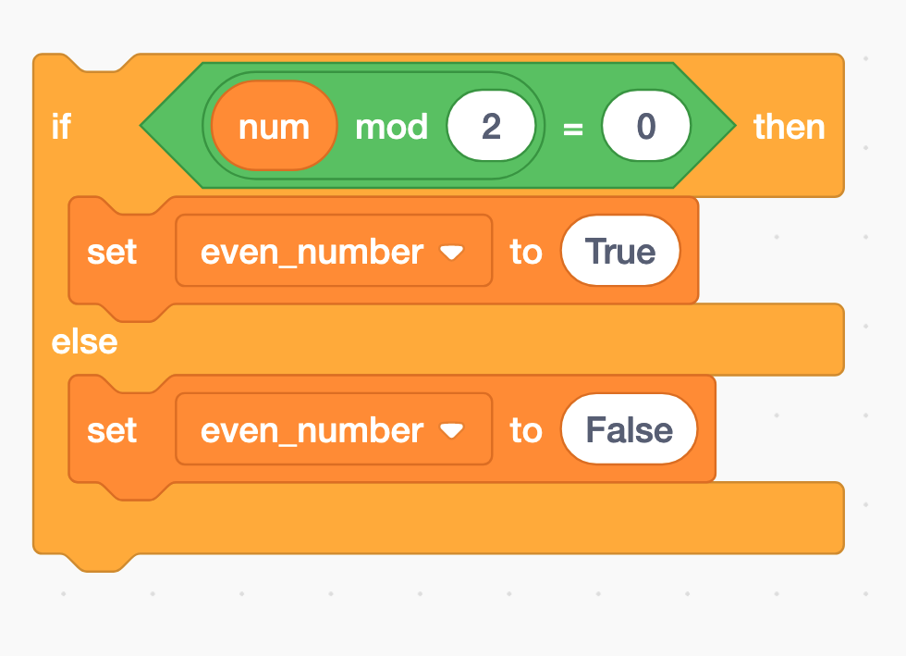
Modulo and if-statements (1)
if num % 2 == 0:
even_number = True
else:
even_number = False

Slide 28
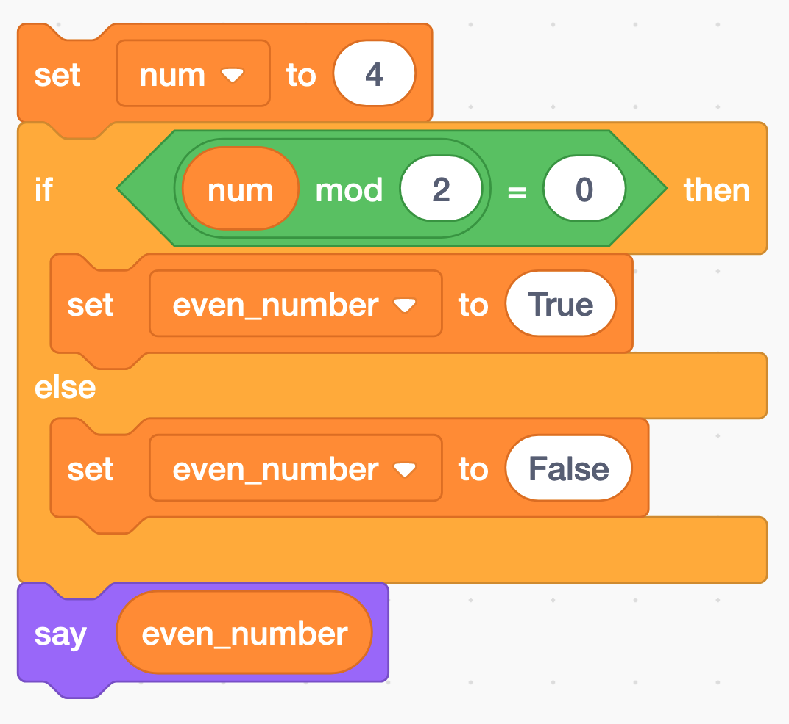
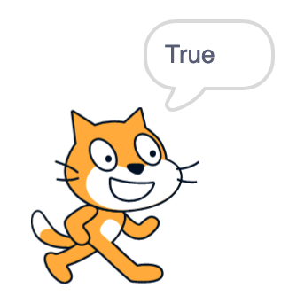
Modulo and if-statements (2)
num = 4
if num % 2 == 0:
even_number = True
else:
even_number = False
print(even_number)

Slide 29
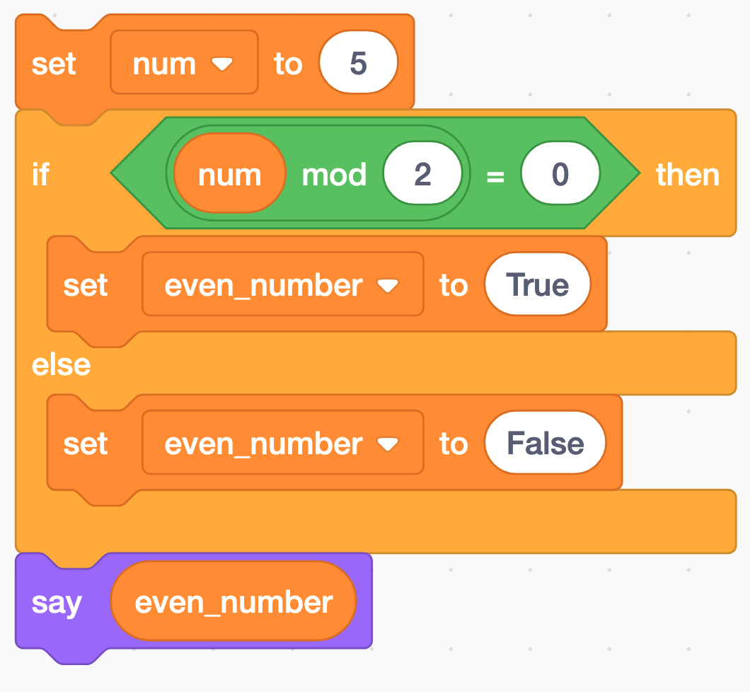
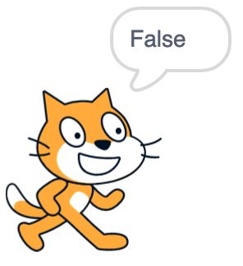
Modulo and if-statements (3)
num = 5
if num % 2 == 0:
even_number = True
else:
even_number = False
print(even_number)

Slide 30
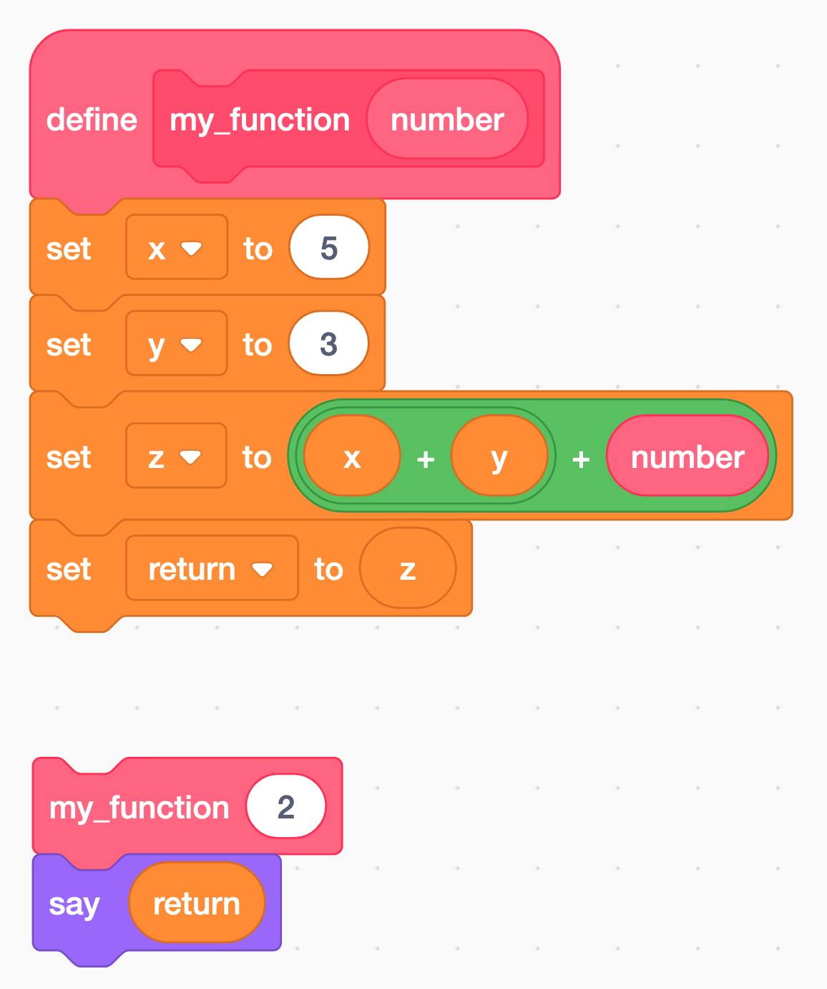
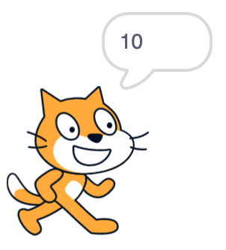
Functions → next week
A function is a block of code that only runs when it is called by its function name
You can pass data, known as parameters, into a function.
A function can return data as a result.
def my_function(number):
x = 5
y = 3
z = x + y + number
return z
print(my_function(2)) # this is the function call

Slide 31
Python data types → next weeks
Python has five standard data types:
Numbers
Sequences (Strings, Lists, Tuples)
Dictionaries
Sets
Boolean
Python sets the variable type based on the value that is assigned to it. Unlike more other languages, python will change the variable type if the variable value is set to another value. For example:
var = 123 # this will create a variable with type integer
var = ‘john’ # the “var” variable has now as type string
type(var) # returns the data type of the “var” variable
var_2 = ‘5’
var_2 = int(var_2) # changes the string variable var_2 to an integer variable (if possible)
int | a = 10 | Integer (whole number)
float | a = 45.67 | (.) Floating point real values
Numbers

Slide 32
Now you have everything you need to start with assignment 2

Slide 33
Dominik Buchegger
dominik.buchegger@student.unisg.ch

